Slide 1


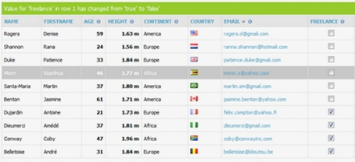
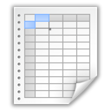
HTML Tables
Tables, Rows, Columns, Cells, Header, Footer, Colspan, Rowspan
Svetlin Nakov
Technical Trainer
www.nakov.com
Software University
http://softuni.bg

Slide 2
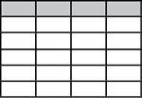

Table of Contents
HTML Tables
Simple Tables
Complete HTML Tables
Data, Header and Footer Cells
Nested Tables
Complex Tables
Cells Width
Cell Spacing and Padding
Column and Row Span

Slide 3
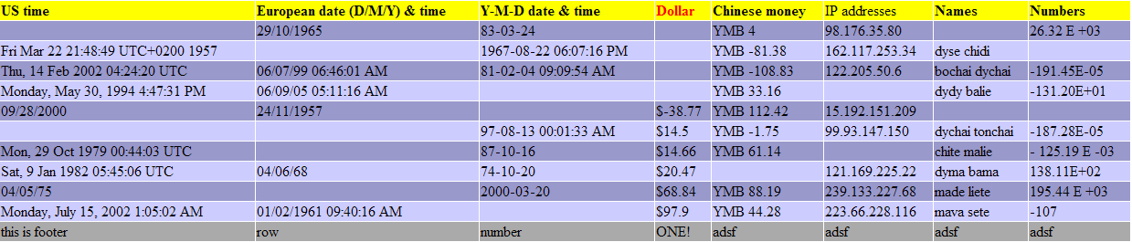
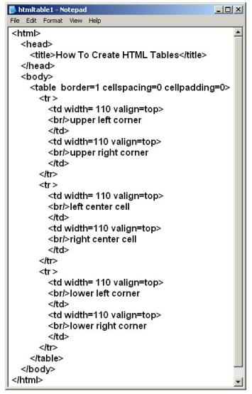
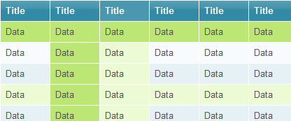
HTML Tables

Slide 4


HTML Tables
Tables represent tabular data
A table consists of one or several rows
Each row has one or more columns
Tables comprised of several core tags:
<table></table>: begin / end the table
<tr></tr>: create a table row
<td></td>: create tabular data (cell)
Tables should not be used for layout
Use CSS floats and positioning styles instead

Slide 5
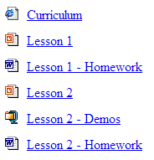
Simple HTML Tables – Example
<table cellspacing="0" cellpadding="5">
<tr>
<td><img src="ppt.gif"></td>
<td><a href="lesson1.ppt">Lesson 1</a></td>
</tr>
<tr>
<td><img src="ppt.gif"></td>
<td><a href="lesson2.ppt">Lesson 2</a></td>
</tr>
<tr>
<td><img src="zip.gif"></td>
<td><a href="lesson2-demos.zip">Lesson 2 - Demos</a></td>
</tr>
</table>

Slide 6

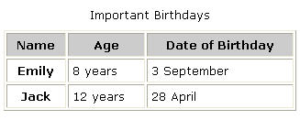

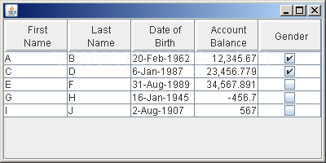
Simple HTML Tables
Live Demo

Slide 7
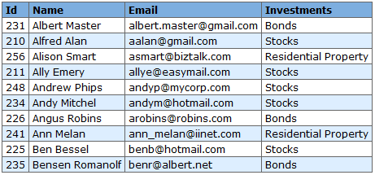
Data Cells and Header Cells
Two kinds of cells in HTML tables
Data cells
Hold the table data – <td>
Header cells
Hold the column names – <th>
Semantically separate data and headers
<tr> <th>Full Name</th> <th>Grade</th> </tr>
<tr> <td>Mariela Anderson</td> <td>Very Good (5)</td> </tr>
<tr> <td>Georgi Georgiev</td> <td>Exellent (6)</td> </tr>

Slide 8
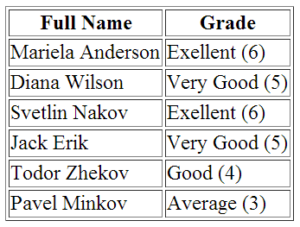


Data and Header Cells
Live Demo

Slide 9
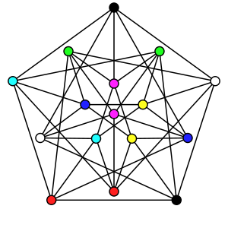
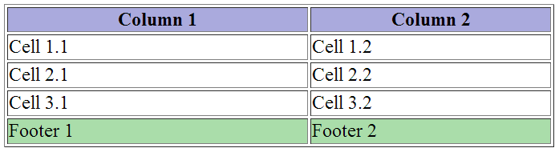

Complete HTML Tables
With Header, Footer and Body

Slide 10
Complete HTML Tables
Table rows split into several semantic sections:
<thead> denotes the table header
Contains <th> elements, instead of <td> cells
<tbody> denotes collection of table rows holding table data
<tfoot> denotes table footer
It may comes before the <tbody> elements, but is displayed last
<colgroup> and <col> define columns
Used to assign column widths

Slide 11
Complete HTML Table: Example
<table>
<colgroup>
<col style="width:100px" /><col />
</colgroup>
<thead>
<tr><th>Column 1</th><th>Column 2</th></tr>
</thead>
<tfoot>
<tr><td>Footer 1</td><td>Footer 2</td></tr>
</tfoot>
<tbody>
<tr><td>Cell 1.1</td><td>Cell 1.2</td></tr>
<tr><td>Cell 2.1</td><td>Cell 2.2</td></tr>
</tbody>
</table>
column width definitions
table header
<th> → header column
footer
Last comes the body (data)

Slide 12
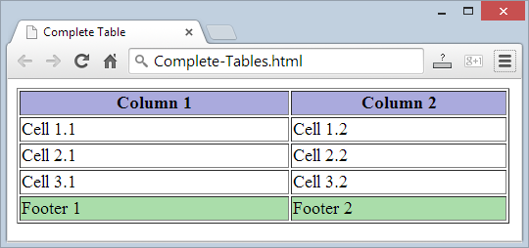
Complete HTML Table: Example (2)
Deprecated: use CSS instead!
<table>
<colgroup>
<col style="width:200px" /><col />
</colgroup>
<thead>
<tr><th>Column 1</th><th>Column 2</th></tr>
</thead>
<tfoot>
<tr><td>Footer 1</td><td>Footer 2</td></tr>
</tfoot>
<tbody>
<tr><td>Cell 1.1</td><td>Cell 1.2</td></tr>
<tr><td>Cell 2.1</td><td>Cell 2.2</td></tr>
</tbody>
</table>
Although the footer is before the data in the code, it is displayed last

Slide 13


Complete HTML Tables
Live Demo

Slide 14


Nested Tables
Tables in Tables in Tables in Tables…

Slide 15
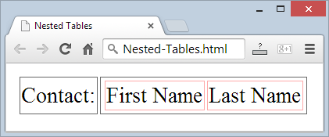
Nested Tables
Table "cells" (<td>) can contain nested tables (tables within tables):
<table>
<tr>
<td>Contact:</td>
<td>
<table>
<tr>
<td>First Name</td>
<td>Last Name</td>
</tr>
</table>
</td>
</tr>
</table>

Slide 16
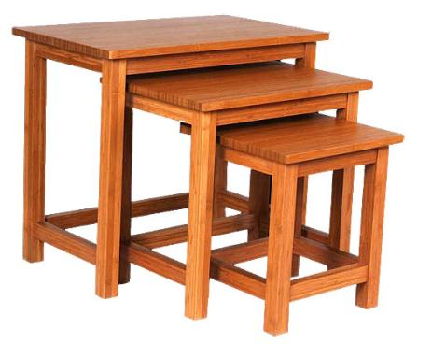
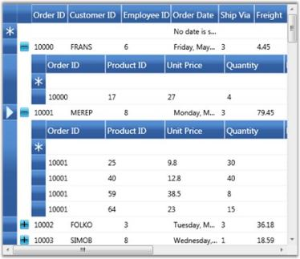
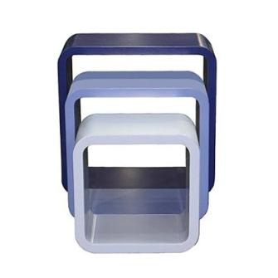
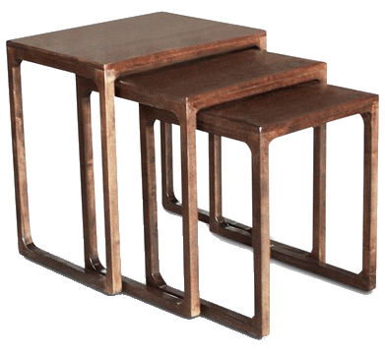
Nested Tables
Live Demo

Slide 17

Complex Tables
With Padding, Spacing, Etc.

Slide 18
Cell Spacing and Padding
Tables have two attributes related to space
cellspacing
Defines the empty space between cells
cellpadding
Defines the empty space around the cell content
cell
cell
cell
cell
cell
cell
cell
cell

Slide 19
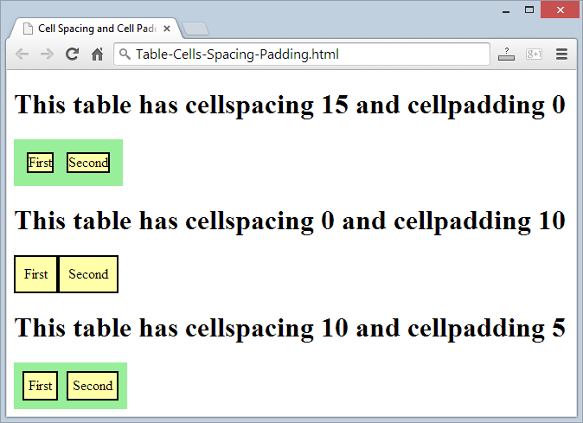
Cell Spacing and Padding – Example
<html>
<head><title>Table Cells</title></head>
<body>
<table cellspacing="15" cellpadding="0">
<tr><td>First</td>
<td>Second</td></tr>
</table>
<br/>
<table cellspacing="0" cellpadding="10">
<tr><td>First</td><td>Second</td></tr>
</table>
</body>
</html>
Deprecated: use CSS instead!

Slide 20
Cell Spacing and Cell Padding
Live Demo

Slide 21


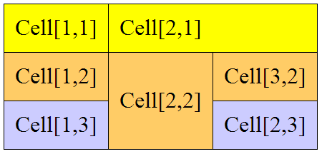
Row and Column Spans
How to Make a Two-Cells Column or Row?

Slide 22
Column and Row Span
Cells have two attributes related to merging
colspan
Defines how many columns the cell occupies
rowspan
Defines how many rows the cell occupies
colspan="1"
colspan="1"
rowspan="2"
rowspan="1"
cell[1,1]
cell[1,2]
cell[1,1]
cell[1,2]
cell[2,1]
cell[2,1]
colspan="2"
rowspan="1"

Slide 23
Column and Row Span – Example
<table cellspacing="0">
<tr class="1">
<td>Cell[1,1]</td>
<td colspan="2">Cell[2,1]</td>
</tr>
<tr class="2">
<td>Cell[1,2]</td>
<td rowspan="2">Cell[2,2]</td>
<td>Cell[3,2]</td>
</tr>
<tr class="3">
<td>Cell[1,3]</td>
<td>Cell[2,3]</td>
</tr>
</table>

Slide 24
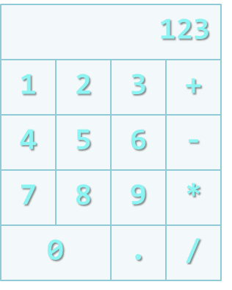
Row and Column Spans
Live Demo

Slide 25

Summary
HTML tables
Defined by <table>, <tr>, <td> tags
Semantic tags: <thead>, <tbody>, <tfoot>
Columns: <colgroup>, <col>, <th>
Column / row span: colspan, rowspan
Styling tables:
Prefer CSS
Old tags: cellspacing, cellpadding, border

Slide 26
HTML Tables
https://softuni.bg/courses/web-fundamentals/

Slide 27
License
This course (slides, examples, demos, videos, homework, etc.) is licensed under the "Creative Commons Attribution-NonCommercial-ShareAlike 4.0 International" license
Attribution: this work may contain portions from
"HTML Basics" course by Telerik Academy under CC-BY-NC-SA license
"CSS Styling" course by Telerik Academy under CC-BY-NC-SA license

Slide 28







SoftUni Diamond Partners

Slide 29





Free Trainings @ Software University
Software University Foundation – softuni.org
Software University – High-Quality Education, Profession and Job for Software Developers
softuni.bg
Software University @ Facebook
facebook.com/SoftwareUniversity
Software University @ YouTube
youtube.com/SoftwareUniversity
Software University Forums – forum.softuni.bg

